Slide 1
PORTFOLIO 2018

Slide 2
SMARTPHONES ROADMAP
2018

Slide 3
FACTS ABOUT THE BRAND
15years
Founded in 2002, Headquarters in Limassol (Cyprus)
20sales offices
in CIS, Europe, Middle East and Africa
R&D,
Czech Republic
QA&QC,
China
30countries
distribute and sale Prestigio devices
(R&D)
Research and Development Center in Czech Republic
HQ,
Cyprus
(QA&QC)
Quality Assurance and
Quality Control in China

Slide 4
BRAND POSITIONING
We bring a new understanding of the word Prestige and, accordingly, to Prestigio - it is prestigious to be rational, to make a reasonable choice, to be free from stereotypes and brands dictatorship.
It is prestigious to be smart and choose your way. To live your way.
We do not say that we will change forever the lives of our consumers, we do not say that we will change the rules of the game and open the doors to the world of the future!
PRESTIGIO IS A FRIENDLY AND RELIABLE BRAND

Slide 5
PRESTIGIO SMARTPHONES ADVANTAGES
CE certificate: products meet the requirements of EU directives (such as enhanced durability of components, higher energy efficiency, protection against radio interference etc.)
RoHS compliant: devices are manufactured without certain hazardous substances (such as lead, mercury, etc.)
IEC certificate: ensures that batteries meet international standards (non-explosive, fire safety, etc.)
NTC protection: battery protection from the overheat when battery reaches 100% or ambience temperature is dangerous for the device
Gilded contacts: prevents sensitive elements from corrosion
Memory by A-brands: stable data storage and reading for longer period of time
A/A class displays: less defective pixels, improved screen response
Enhanced USB/audio ports: tested to resist high pressure for improved durability

Slide 6
PRESTIGIO SMARTPHONES ADVANTAGES
High quality accessories in the box: USB cable and charger are tested for improved durability
Screen protective film: free customized film to protect your device’s screen from scratches in the box and in use
Charging control: control in every project of the current balance to make sure device is effectively charging while working with source-demanding applications and services
OTA: over-the-air firmware updates
GMS: Google certification, latest OS updates & security patch integrations
Translated interface: high quality interface translation to 20 languages

Slide 7
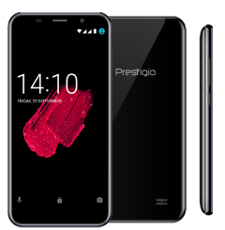
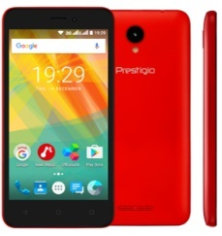
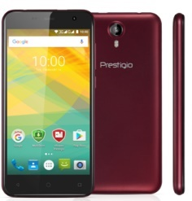
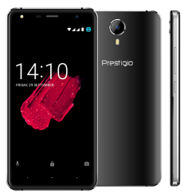
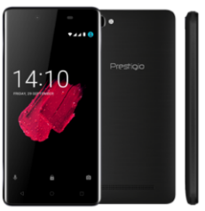
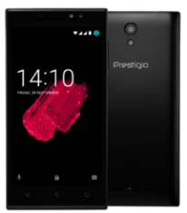
COMPARISON
Market name | Wize Q3 | Wize G3 | Muze B3 | Muze D5 LTE | Grace P5 | Muze C5
Article | PSP3471DUO | PSP3510DUO | PSP3512DUO | PSP5518DUO | PSP5515DUO | PSP5510DUO
Positioning | First price 18:9 | 5.0” first price | 5.0” HD 3G | 5.0” HD 4G metal frame | 4000 mAh 5.0” 3G | 5000mAh 5.0” 3G
Display | 4.95” FW+(480*960), 18:9, 2.5D | 5.0” (480 x 854) TN | 5.0” (720 x 1280) IPS, 2.5D | 5.0” (720 x 1280) IPS | 5.0” (720 x 1280) IPS | 5.0” (720 x 1280) IPS
Processor | SC7731C 1.2GHz quad core | SC7731C 1.2GHz quad core | MT6580 1.3 GHz quad core | SC9832 1.3 GHz quad core | MT6580 1.3 GHz quad core | MT6580 1.3 GHz quad core
Memory | 1GB + 8GB | 1GB + 8GB | 1GB + 8GB | 1GB + 8GB | 1GB + 8GB | 1GB + 8GB
Battery | 2000 mAh Li-ion | 2000 mAh Li-ion | 2000 mAh Li-ion | 2400 mAh Li-ion | 4000 mAh Li-po | 5000 mAh Li-ion
Android | Android 7.0 | Android 6.0 | Android 6.0 | Android 7.0 | Android 7.0 | Android 7.0
Connectivity | Dual SIM, 3G | Dual SIM, 3G | Dual SIM, 3G | Dual SIM, 4G | Dual SIM, 3G | Dual SIM, 3G
Imaging | 2.0MP flash + 8.0MP AF flash | 0.3MP + 5.0MP flash | 2.0MP + 8.0MP AF BSI flash | 2.0MP + 8.0MP AF flash | 2.0MP + 8.0MP AF flash | 2.0MP flash + 8.0MP AF flash

Slide 8
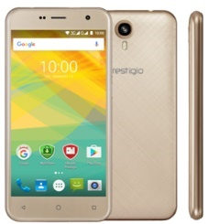
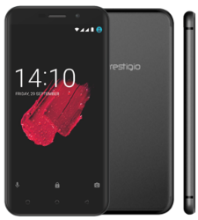
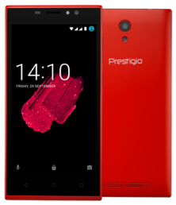
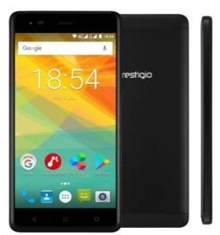
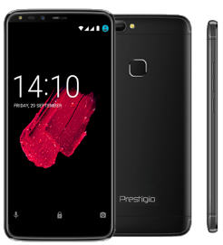
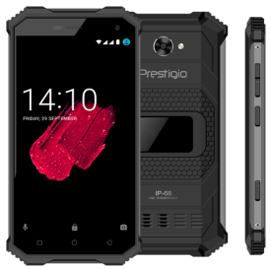
COMPARISON
Market name | Muze B7 | Grace M5 LTE | Muze C7 LTE | Grace R5 LTE | Grace P7 LTE | Muze G7 LTE
Article | PSP7511DUO | PSP5511DUO | PSP7510DUO | PSP5552DUO | PSP7570DUO | PSP7508DUO
Positioning | 5.0” 2+16GB 3G | 5.0” slim 4G | 5000mAh 5.0” 4G | 5.5” HD 4G | 5.7” 18:9 HD LTE | IP68 LTE 2+16GB
Display | 5.0” (720 x 1280) IPS, 2.5D | 5.0” (720 x 1280) IPS, 2.5D | 5.0” (720 x 1280) IPS | 5.5” (720 x 1280) IPS, 2.5D | 5.7” HD +, (720*1440) IPS, full screen, 2.5D, full lam | 5.0” HD (720 x 1280) IPS, Gorilla Glass 3
Processor | MT6580 1.3 GHz quad core | MT6737 1.3GHz quad core 64-bit | MT6737 1.3GHz quad core 64-bit | MT6737 1.3GHz quad core 64-bit | MT6737 1.3GHz quad core 64-bit | MT6737 1.3GHz quad core 64-bit
Memory | 2GB + 16GB | 1GB + 16GB | 1GB + 8GB | 1GB + 16GB | 2GB + 16GB | 2GB + 16GB
Battery | 2300 mAh Li-po | 2400 mAh Li-po | 5000 mAh Li-ion | 3000 mAh Li-po | 3000 mAh Li-ion | 4000 mAh Li-po
Android | Android 6.0 | Android 7.0 | Android 7.0 | Android 7.0 | Android 7.0 | Android 7.0
Connectivity | Dual SIM, 3G | Dual SIM, 4G | Dual SIM, 4G | Dual SIM, 4G | Dual SIM, 4G | Dual SIM, 4G
Imaging | 2.0MP + 13.0MP AF flash | 2.0MP + 13.0MP AF flash | 2.0MP + 13.0MP AF flash | 2.0MP + 13.0MP AF flash | 5.0MP + 13.0MP AF flash | 2.0MP + 13.0MP AF flash

Slide 9
TABLETS ROADMAP
2018

Slide 10
PRESTIGIO TABLETS ADVANTAGES
CE certificate: products meet the requirements of EU directives (such as enhanced durability of components, higher energy efficiency, protection against radio interference etc.)
RoHS compliant: devices are manufactured without certain hazardous substances (such as lead, mercury, etc.)
IEC certificate: ensures that batteries meet international standards (non-explosive, fire safety, etc.)
NTC protection: battery protection from the overheat when battery reaches 100% or ambience temperature is dangerous for the device
Gilded contacts: prevents sensitive elements from corrosion
Memory by A-brands: stable data storage and reading for longer period of time
A/A class displays: less defective pixels, improved screen response
Charging control: control in every project of the current balance to make sure device is effectively charging while working with source-demanding applications and services
Enhanced USB/audio ports: tested to resist high pressure for improved durability

Slide 11
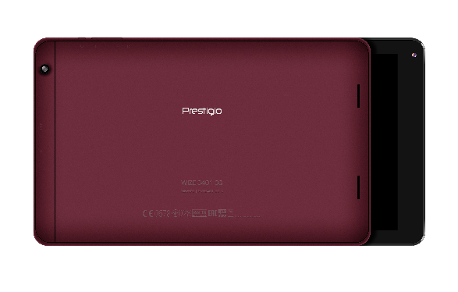
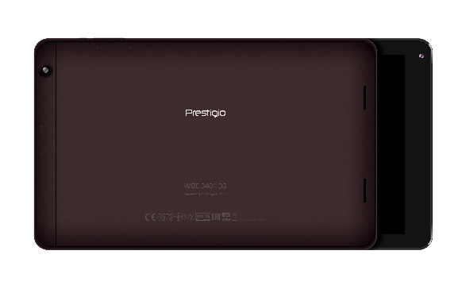
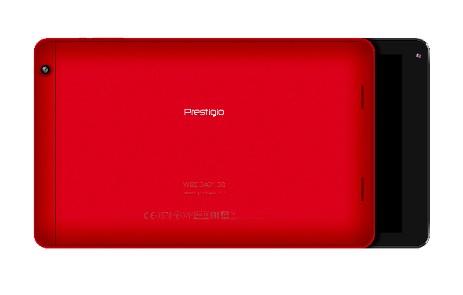
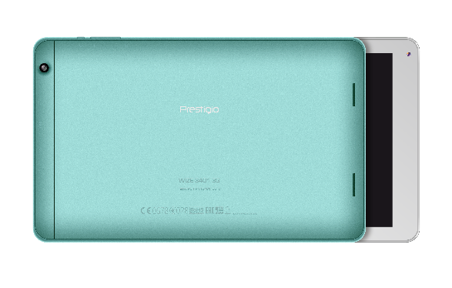
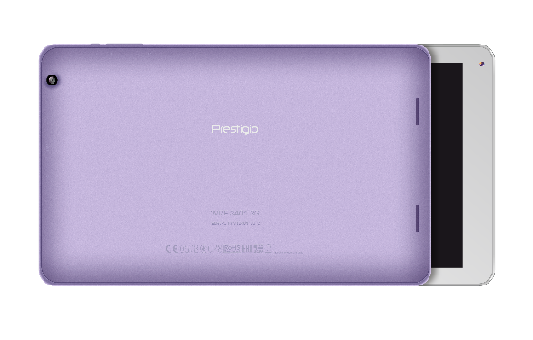
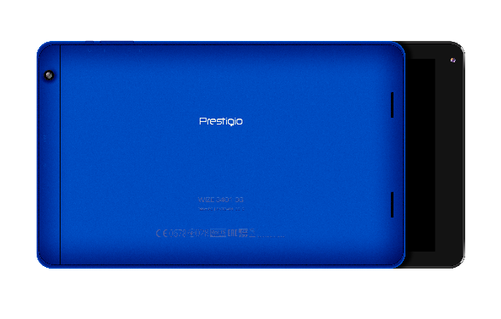
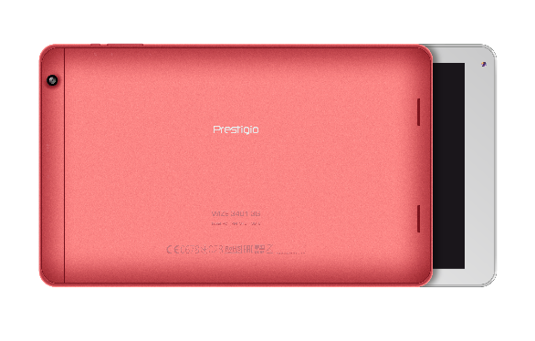
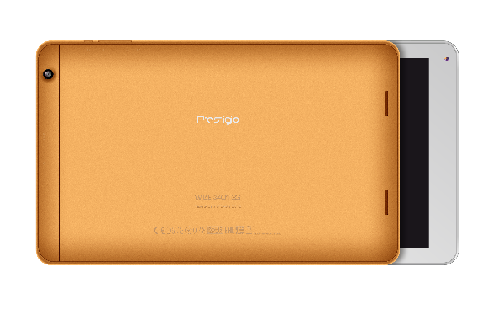
COLOR OPTIONS (depends on MOQ)

Slide 12
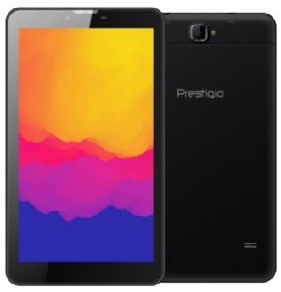
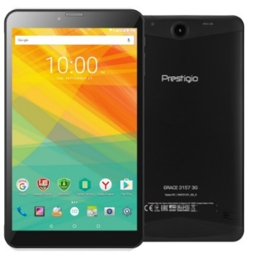
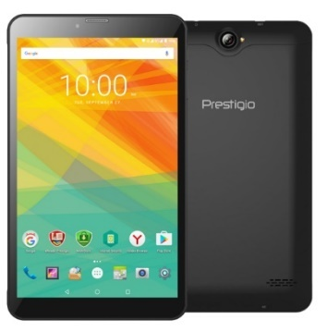
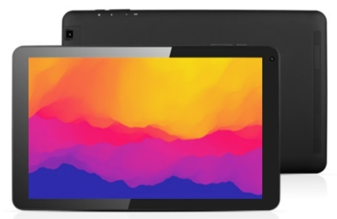
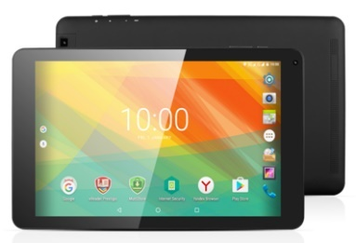
3G TABLETS COMPARISON
Positioning | 7.0” entry 3G Android 7.0 metal | 7.0” HD 3G Android 7.0 in metal case | 8.0” HD 3G Android 7.0 in metal case | 10.1” HD 3G Android 7.0 | 10.1” HD 3G Android 6.0
Market name | Wize 3107 3G | Grace 3157 3G | Muze 3708 3G | Wize 3141 3G | Wize 3131 3G
Article | PMT3107_3G | PMT3157_3G_C | PMT3708_3G_C/D | PMT3141_3G | PMT3131_3G_C
Display | 7.0” WSVGA (600 x 1024) IPS | 7.0” WXGA (720 x 1280) IPS | 8.0” WXGA (800 x 1280) IPS | 10.1” WXGA (1280 x 800) IPS | 10.1” WXGA (1280 x 800) IPS
Processor | MT8321 1.3GHz quad core | MT8321 1.3GHz quad core | MT8321 1.3GHz quad core | MT8321 1.3 GHz Quad Core | MT8321 1.3 GHz Quad Core
Memory | 1GB RAM + 8GB ROM | 1GB RAM + 8GB internal storage | 1GB RAM + 8/16GB internal storage | 1GB RAM + 8GB internal storage | 1GB RAM + 8GB internal storage
Battery | 2800 mAh Li-ion | 2800 mAh Li-ion | 4000 mAh Li-ion | 5000 mAh Li-ion | 5000 mAh Li-ion
Android | Android 7.0 Nougat | Android 7.0 Nougat | Android 7.0 Nougat | Android 7.0 Nougat | Android 6.0 Marshmallow
Connectivity | Dual SIM: 3G, Wi-Fi, BT, GPS, FM | Dual SIM: 3G, Wi-Fi, BT, GPS, FM | Dual SIM: 3G, Wi-Fi, BT, GPS, FM | Dual SIM: 3G, Wi-Fi, BT, GPS, FM | Dual SIM: 3G, Wi-Fi, BT, GPS, FM
Imaging | 2.0MP rear + 0.3MP front | 2.0MP rear + 0.3MP front | 2.0MP rear + 0.3MP front | 2.0MP rear + 0.3MP front | 2.0MP rear + 0.3MP front

Slide 13
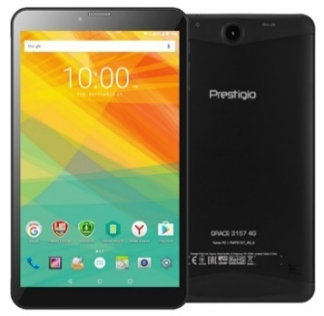
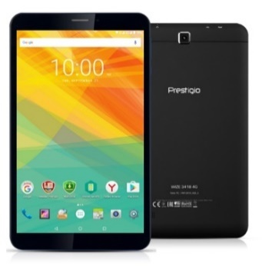
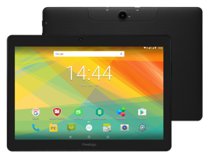
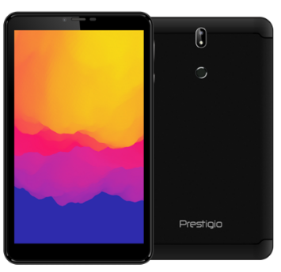
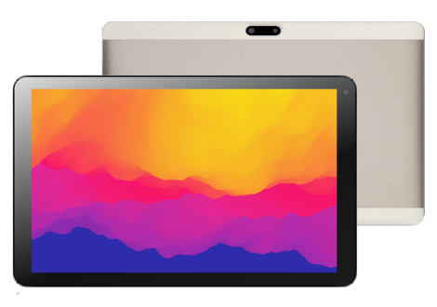
4G TABLETS COMPARISON
Positioning | 7.0” entry 4G Android 7.0 metal | 7.0” HD 4G Android 7.0 metal | 8.0” HD 4G Android 6.0 | 10.1” 4G Android 7.0 16Gb metal | 8.0” fingerprint scanner, FullHD, 2+16GB, metal | 10.1” FullHD, 2+16GB, metal
Name | Wize 3107 4G | Grace 3157 4G | Wize 3418 4G | Grace 3101 4G | Grace 5778 4G | Grace 5771 4G
Article | PMT3107_4G | PMT3157_4G_C | PMT3418_4G_C/D | PMT3101_4G | PMT5778_4G | PMT5771_4G
Display | 7.0” WSVGA (600 x 1024) IPS | 7.0” WXGA (720 x 1280) IPS | 8.0” WXGA (800 x 1280) IPS | 10.1” WXGA (1280 x 800) IPS | 8.0” FullHD (1200x1920) IPS, 2.5D | 10.1” FullHD (1920x1200) IPS
Processor | MT8735 quad core | MT8735 quad core | MT8735 quad core | MT8735 quad core | MT8735 quad core | MT8735 quad core
Memory | 1GB RAM + 8GB ROM | 1GB RAM + 8GB ROM | 1GB RAM + 8/16GB ROM | 2GB RAM + 16GB ROM | 2GB RAM + 16GB ROM | 2GB RAM + 16GB ROM
Battery | 2800 mAh Li-ion | 2800 mAh Li-ion | 4200 mAh Li-ion | 6100 mAh Li-ion | 4000 mAh Li-ion | 5600 mAh Li-ion
Android | Android 7.0 Nougat | Android 7.0 Nougat | Android 6.0 Marshmallow | Android 7.0 Nougat | Android 7.0 Nougat | Android 7.0 Nougat
Connectivity | Dual SIM: 4G, Wi-Fi, BT, GPS, FM | Dual SIM: 4G, Wi-Fi, BT, GPS, FM | 4G, Wi-Fi, BT, GPS, FM | Dual SIM: 4G, Wi-Fi, BT, GPS, FM | 4G, Wi-Fi, BT, GPS, FM | 4G, Wi-Fi, BT, GPS, FM
Imaging | 2.0MP rear + 0.3MP front | 2.0MP rear + 0.3MP front | 2.0/5.0MP rear + 0.3/2.0MP front | 2.0MP rear + 0.3MP front | 5.0MP rear + 2.0MP front | 8.0MP rear + 2.0MP front

Slide 14
SMARTBOOKS ROADMAP
2018

Slide 15
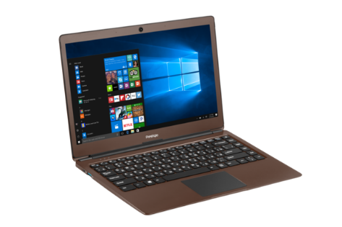
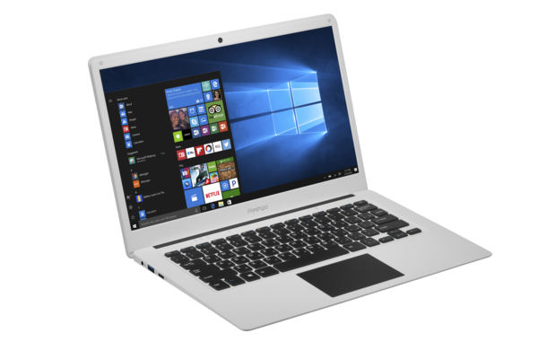
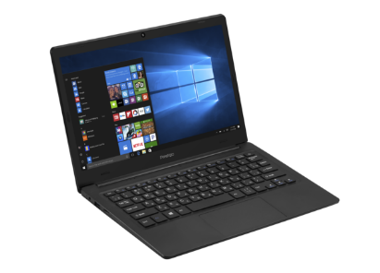
SMARTBOOKS: CURRENT LINE-UP
 | Smartbook 133S01 | Smartbook 141S01 | Smartbook 141C01 | Smartbook 141C02 | Smartbook 116C01 | Smartbook 156C01
Display | 13.3” IPS 1920*1080 | 14.1” IPS 1920*1080 | 14.1” IPS 1920*1080 | 14.1” IPS 1920*1080 | 11.6” IPS 1920*1080 | 15.6” TN 1366*768
Body | Metallic | Metallic | Plastic | Plastic | Plastic | Plastic
CPU | Intel® Mobile Celeron® N3350 (Apollo Lake) (2M cache, up to 2.4 GHz) | Intel® Mobile Celeron® N3350 (Apollo Lake) (2M cache, up to 2.4 GHz) | Intel® Atom™ Z8350 (Cherry Trail) (2M cache, up to 1.92 GHz) | Intel® Mobile Celeron® N3350 (Apollo Lake) (2M cache, up to 2.4 GHz) | Intel® Atom™ Z8350 (Cherry Trail) (2M cache, up to 1.92 GHz) | Intel® Mobile Celeron® N3350 (Apollo Lake) (2M cache, up to 2.4 GHz)
OS | Windows 10 Home / Windows 10 Pro | Windows 10 Home / Windows 10 Pro | Windows 10 Home / Windows 10 Pro | Windows 10 Home / Windows 10 Pro | Windows 10 Home / Windows 10 Pro | Windows 10 Home / Windows 10 Pro
Memory | 3 GB + 32 GB | 3 GB + 32 GB | 2 GB + 32 GB | 3 GB + 32 GB | 2 GB + 32 GB | 3 GB + 32 GB
Camera | Front 0.3 MP | Front 0.3 MP | Front 0.3 MP | Front 0.3 MP | Front 0.3 MP | Front 0.3 MP
Connectivity | WI-FI, BT | WI-FI, BT | WI-FI, BT | WI-FI, BT | WI-FI, BT | WI-FI, BT
Power | 7.4V@5000 mAh | 7.4V@5000 mAh | 10000 mAh | 7.4V@5000 mAh | 10000 mAh | 9000 mAh
Ports | SSD slot M.2 SATA (Type 2242), microSD card, 2*USB 3.0, micro HDMI | SSD slot M.2 SATA (Type 2242), microSD card, 2*USB 3.0, micro HDMI | USB 3.0, USB 2.0, microSD card, mini HDMI | 2.5’’ HDD slot, RJ-45, USB 3.0, USB 2.0, microSD card, mini HDMI | USB 3.0, USB 2.0, microSD card, mini HDMI | 2.5’’ HDD slot, RJ-45, USB 3.0, USB 2.0, microSD card, mini HDMI

Slide 16
DVR ROADMAP
2018

Slide 17
CE, RoHS, IEC 62133 v.2 :2018

Slide 18
COMPETITIVE ADVANTAGES
CE CERTIFICATION products meet the requirements of EU directives.
ROHS COMPLIANT devices are manufactured without certain hazardous substances.
IEC CERTIFICATE ensures that batteries meet international standards (non-explosive, fire safety, etc.)
MEMORY BY A BRAND stable data storage and reading for longer period of time.
ENHANCED USB PORT tested to resist high pressure for improved durability.
OVP and OCP Over Voltage Protection and Over Voltage Protection reduce the power dissipation in the load during the vehicle start, which can reduce the risks of fire and heat damage.
DATA TRANSFER A possibility to download the firmware update from our website.
NTC In the condition of normal room temperature, it is expected that the battery will remain under 50℃, and this won't damage the device.
THREE FILE PROTECTION in an emergency situation the three files will be protected from overwriting: one file – before incident, second – during, and the third – after.
GLASS LENS Due to its good optical properties and resistance to scratching, it offers much better clarify.
HIGH QUALITY ACCESSORIES IN THE BOX. All new 5 series DVR’s (f.e RR535W and RR530w) will have 2 x USB charger and plastic crowbar for the cable management.

Slide 19
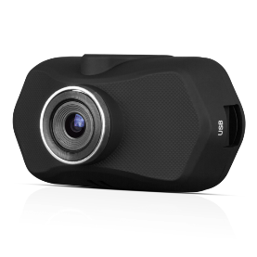
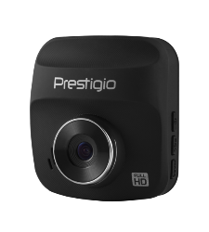
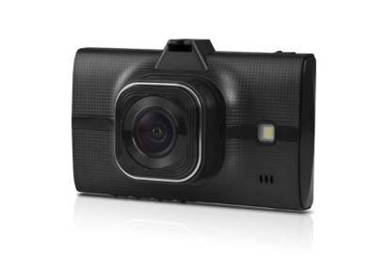
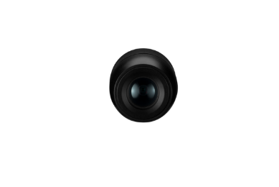
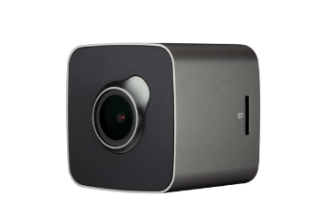
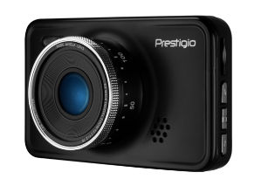
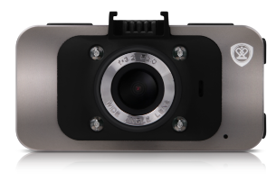
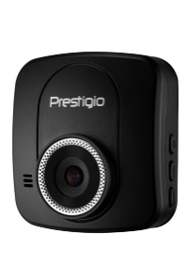
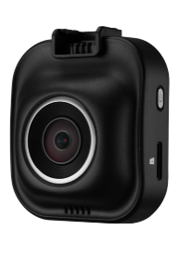
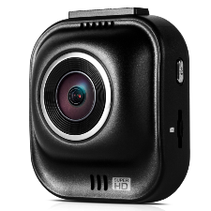
ROADRUNNER PORTFOLIO
ENTRY LEVEL / 1-SERIES FULL HD@25fps
PCDVRR140
BASIC LEVEL / 3 - SERIES FULL HD@25fps
PCDVRR325
PCDVRR330i
MIDDLE LEVEL / 5-SERIES FULL HD@30fps
PCDVRR526/527
PCDVRR526DL/527DL
PCDVRR530W
PCDVRR545GPS
HIGH LEVEL / 5-SERIES SUPER HD@30fps
PCDVRR523
PCDVRR535W
PCDVRR585
PCDVRR585GPS

Slide 20
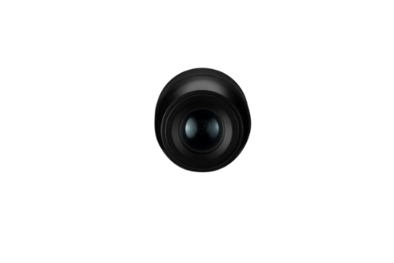
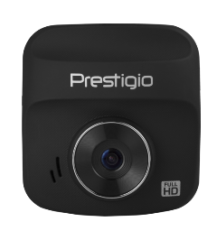
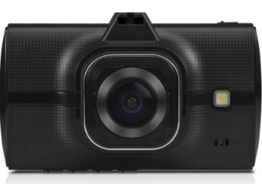
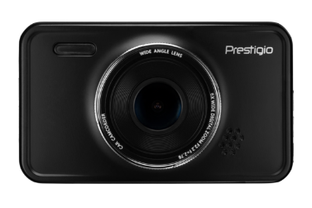
ROADRUNNER COMPARISON CHART
Article | PCDVRR140 | PCDVRR325 | PCDVRR330i | PCDVRR526/527 | PCDVRR526DL/527DL
Screen | 1.5" | 480 x 240 px | 2" | 960 x 240 px | 3" | 960 x 240 px | 3.0" TFT | 960x240 px | 3.0" TFT | 480x240 px
Image sensor | H42 | H42 | GalaxyCore 1024 | GalaxyCore 2023 | GalaxyCore 2023
Processor | NOVATEK 96223 | NOVATEK 96223 | NOVATEK 96223 | NOVATEK 96658 | NOVATEK 96658
Lens Layers | 4 – Layers | 4 – Layers | 4 – Layers | 5-Layers | 5-Layers
Max video resolution | Full HD 1920x1080@25fps | Full HD 1920x1080@25fps | Full HD 1920x1080@25fps | Full HD 1920x1080@30fps | 1camera: FHD 1920x1080@30 fps 2camera: VGA 848x480@30fps
Photo resolution | 12 MP | 12 MP | 12 MP | 12MP | 12MP
Viewing angle | 110° | 110° | 120° | 140° | 140°/90°
Cradle type | Suction cup | Suction cup | Suction cup | Suction cup | Suction cup
Battery | 200 mAh | 240 mAh | 200 mAh | 180 mАh | 180 mАh
GPS/Wifi | N/A | N/A | N/A | N/A | N/A

Slide 21
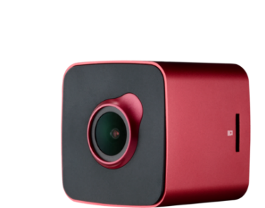
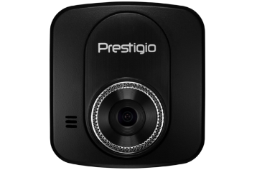
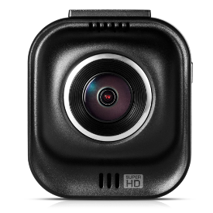
ROADRUNNER COMPARISON CHART
Article | PCDVRR523 | PCDVRR530W | PCDVRR535W | PCDVRR585 | PCDVRR585GPS | PCDVRR545GPS
Screen | 2.0" | 320 x 240 px | 1.5" | 320 x 240 px | 2“ | TBD px | 2“ | 960x240 | 2“ | 960x240 | 2.7" | 960 x 240 px
Image sensor | Aptina 0330 | SONY IMX323 | OmniVision 4689 | OmniVision 4689 | OmniVision 4689 | Aptina 0330
Processor | GENARL PLUS 2159 | MSTAR 8328P | MSTAR 8328Q | AMBARELLA A7LA50 | AMBARELLA A7LA50 | NOVATEK 96650
Lens Layers | 6-Layers | 6-Layers | 6-Layers | 6-Layers | 6-Layers | 6-Layers
Max video resolution | Full HD 1920x1080@30fps | Full HD 1920x1080@30fps | 2K 2560x1440 HDR@30fps 1920x1080@60fps | Super HD 2560x1080@30fps | Super HD 2560x1080@30fps | Full HD 1920x1080@30fps
Photo resolution | 12 MP | 12 MP | 12 MP | 16 MP | 16 MP | 12 MP
Viewing angle | 120° | 140° | 140° | 160° | 160° | 170°
Cradle type | Suction cup | 3M Mount | Suction cup | Suction cup | Suction cup | Suction cup
Battery | 320 mАh | 150 mАh | 240 mАh | 180 mAh | 320 mAh | 130 mАh
GPS/Wifi |  | N/A | Wifi | N/A | GPS | GPS

Slide 22
GPS NAVIGATORS ROADMAP
2018

Slide 23
CE, RoHS, IEC 62133:2012

Slide 24
WHY TO USE GPS NAVIGATOR?
DON`T GET LOST
SAVE YOUR TIME
BE INFORMED
Use car navigation to get from point A to point B.
Update maps database from Internet.
Follow voice guidance for easy navigation.
See site information data as building names, addresses, representative structures etc.
Find out your location or any other place.
Сalculate faster or closest route to destination.
See Points of Interests (POi)
Send information to the authorities to alert if you are in trouble.
Know your travel distance and estimated time till destination.
Receive warnings when exceeding allowed speed.
Receive road data on road cofiguration, connections, condition etc.

Slide 25
WHY TO USE GPS NAVIGATOR?
PRESTIGIO GEOVISION
DESIGN
SOFTWARE
QUALITY CONTROL
High-quality materials in combination of discreet design
Designed to be practical, compact and highly portable
Preinstalled 3D maps
Latest Android and Windows CE operational systems
GPS Receiver, FM- transmitter, digital TV and HDMI
Developed by specialists
Products meet the requirements of EU directives.
Global network of service centers

Slide 26
GPS NAVIGATION COMPARISON CHART (w/o maps)
 | GeoVision 5059 PGPS505900004GB00 | GeoVision 5066 PGPS506600004GB00 | GeoVision 5068 PGPS506800004GB00 | GeoVision 7059 PGP705900004GB00 | GeoVision 7059 PGP705900008GB00
Screen | 5" 400 x 272 | 5" 800 x 480 | 5" 800 x 480 | 7" 800 x 480 | 7" 800 x 480
Processor | MSB2531A / 800 MHz | MSB2531A / 800 MHz | MSB2531A / 800 MHz | MSB2531A / 800 MHz | MSB2531A / 800 MHz
Memory | 128 MB RAM / 4 GB | 128 MB RAM / 4 GB | 128 MB RAM / 4 GB | 128 MB RAM / 4 GB | 256MB RAM / 8 GB
OS | Windows CE 6.0 | Windows CE 6.0 | Windows CE 6.0 | Windows CE 6.0 | Windows CE 6.0
Software | w/o | w/o | w/o | w/o | w/o
Battery | Lithium Polymer Battery / 950 mAh | Lithium Polymer Battery / 950 mAh | Lithium Polymer Battery / 950 mAh | Lithium Polymer Battery / 1500 mAh | Lithium Polymer Battery / 1500 mAh
Accessories | Cradle, Car Charger, Stylus | Cradle, Car Charger, USB cable, Stylus | Cradle, Car Charger, USB cable, Stylus | Cradle, Car Charger, Stylus | Cradle, Car Charger, Stylus

Slide 27
GPS NAVIGATION COMPARISON CHART Sygic Android
 | GaoVision Tour 3 PGPS7799BG08GBSG | GaoVision Tour 3 PGPS7799CEU16GBSG
Screen | 7” 1280 x 720 | 7” 1280 x 720
Processor | MT8321 1.3 GHz Quad Core | MT8321 1.3 GHz Quad Core
Memory | 1 GB RAM / 8 GB internal | 1 GB RAM / 16 GB internal
OS | Android 7.0 | Android 7.0
Software | Sygic Full Europe Tom Tom maps 3 years update | Sygic Full Europe Tom Tom maps 3 years update
Battery | Lithium Polymer Battery / 2800 mAh | Lithium Polymer Battery / 2800 mAh
Accessories | Cradle, Car Charger, Rechargeable battery | Cradle, Car Charger, Rechargeable battery

Slide 28
Navigation software -
Sygic advantages
Map update 3 years
High quality TomTom maps
Lifetime traffic for faster route*
3D Cities & Landscape*
Voice Guidance
Millions of free pre-installed POIs
Warnings for exceeded Speed Limit. Warnings for over 30 000 speed cameras.
Lane assistant
Three Alternative Routes to choose from
Multiple Waypoints
Head-up Display (HUD)*
Real-time route sharing*
Dash cam that records even while you are navigating*
Find cheapest gas based on your gas type*
Address/GPS coordinates entry by copy & paste*
Pedestrian Navigation & Tourist attractions *
Europe Countries included:
100% coverage of:
Andorra, Austria, Belgium, Cyprus, Czech republic, Denmark, Estonia, Finland, France, Germany, Gibraltar, Greece, Hungary, Iceland, Ireland, Italy, Latvia, Liechtenstein, Lithuania, Luxembourg, Malta, Monaco, Montenegro, Netherlands, Norway, Poland, Portugal, Romania, San Marino, Serbia, Slovakia, Slovenia, Spain, Sweden, Switzerland, Turkey, United Kingdom, Vatican City
Croatia 70%
Bulgaria 77%
Slovenia 87%
Transit roads only:
Albania, Ukraine, Belarus, Russia, Bosnia and Herzegovina, Moldova, The Former Yugoslav Republic of Macedonia
* Only on Android

Slide 29
CELLULAR PHONES ROADMAP 2018

Slide 30
PRESTIGIO CELL PHONES LINE-UP
Prestigio successfully launches dual-SIM feature phones in 2016.
Models are split into 3 series: Wize (entry-level), Muze (mid-level, entertainment) and Grace (high-level, devices with slim and beautiful design)
All the phones are available in 2 color options: black and white
Line-up contains special model designed for seniors
GM for feature phones is from 20% to 30%, and last year more than 200K units were ordered and pre-sold
Feature phones provide good opportunities for cross-selling and promotion of smartphones
In 2017 line-up will be enhanced with flip phone and stylish metal phone

Slide 31
PRESTIGIO PHONES COMPETITIVE ADVANTAGES
IEC certificate: ensures that batteries meet international standards (non-explosive, fire safety, etc.)
NTC protection: battery protection from the overheat when battery reaches 100% or ambience temperature is dangerous for the device
Translated interface: high quality interface translation to 7 languages
RoHS compliant: devices are manufactured without certain hazardous substances (such as lead, mercury, cadmium, etc.)
Enhanced USB/audio ports: tested to resist high pressure for improved durability

Slide 32
Wize D1 | PFP1181DUO
DIMENSIONS & WEIGHT | H: 113 mm, W: 47.5 mm, D: 13.8 mm; 67 g
COLOURS | Black
DISPLAY | 1.8” QQVGA (128 x 160) TN
PROCESSOR | SC6531E
MEMORY | 32 Mb RAM + 32 Mb internal storage
 | Expandable memory: microSD card up to 32GB
BATTERY | 600 mAh li-ion
CONNECTIVITY | SIM card slot: dual SIM
 | Charging connector: micro USB, Audio Jack: 3.5 mm
BANDS | 2G GSM: 900/1800
CAMERA | -
OTHER | Bluetooth, FM, MP3, MP4, interface translation to 7 languages
IN THE BOX | Battery, charger

Slide 33
Grace B1| PFP1242 2.4” flip phone
DIMENSIONS & WEIGHT | H: 106 mm, W: 52 mm, D: 14.5 mm (slim flip phone);
COLOURS | Red-black; blue-black
DISPLAY | 2.4” QVGA (240 x 320) TN
PROCESSOR | MT6261D
MEMORY | 32 Mb RAM + 32 Mb internal storage
 | Expandable memory: microSD card up to 32GB
BATTERY | 750 mAh li-po
CONNECTIVITY | SIM card slot: dual SIM
 | Charging connector: micro USB, Audio Jack: 3.5 mm
BANDS | 2G GSM: 850/900/1800/1900 MHz
CAMERA | 0.3MP with LED flash
OTHER | Bluetooth, FM, MP3, MP4, interface translation to 7 languages
IN THE BOX | charger, battery

Slide 34
Grace A1| PFP1281 2.8” SLIM Metal Phone
DIMENSIONS & WEIGHT | H: 136 mm, W: 58 mm, D: 8.5 mm (slim body);
COLOURS | Golden+Golden, Silver+Red, Silver+Grey; metal A-housing
DISPLAY | 2.8” QVGA (240 x 320) TN
PROCESSOR | MT6261D
MEMORY | 32 MB RAM + 32 MB internal storage
 | Expandable memory: microSD card up to 32GB
BATTERY | 950 mAh li-po
CONNECTIVITY | SIM card slot: dual SIM
 | Charging connector: micro USB, Audio Jack: 3.5 mm
BANDS | 2G GSM: 850/900/1800/1900 MHz
CAMERA | 0.3MP with LED flash
OTHER | Vibro, Bluetooth, FM, MP3, MP4, interface translation to 7 languages
IN THE BOX | charger, battery

Slide 35
Rugged IP68 feature phone, PFP1244
DIMENSIONS & WEIGHT | H: 132.5 mm, W: 57 mm, D: 9.2 mm (slim body);
COLOURS | TDB, unibody
DISPLAY | 2.4” QVGA (240 x 320) TN
PROCESSOR | MT6261D
MEMORY | 32 Mb RAM + 32 Mb internal storage
 | Expandable memory: microSD card up to 32GB
BATTERY | 1400 mAh li-poly
CONNECTIVITY | SIM card slot: dual SIM
 | Charging connector: micro USB, Audio Jack: 3.5 mm
BANDS | 2G GSM: 900/1800 MHz
CAMERA | 0.3MP with LED flash.
OTHER | IP-68, Bluetooth, FM,
IN THE BOX | charger, battery, earphones

Slide 36
Thank you!

